Slide 1
Supervisor Training Workshop
New Employee
Hiring Process

Slide 2
Session Overview
Overview of Hiring Process
Review of new ‘jobs’ pages
Introduction to ApplicantPRO
Posting student jobs (student employee supervisors only)

Slide 3
Overview of Hiring Process
Interview
Hire
Assess Needs
Recruit
Onboard

Slide 4
Assessing Needs
Interview
Hire
Assess Needs
Recruit
Onboard
For a new position:
Establish need for position
Obtain VP and budget approval
Develop a job description
Submit to ES for comp & title analysis
For a replacement position:
Establish need for position
Review/revise job description
Submit to ES for comp & title analysis

Slide 5
Recruiting
Interview
Hire
Assess Needs
Recruit
Onboard
Managers works with ES to determine appropriate advertising channel(s)
ES advertises, screens and “spotlights” candidates
Managers review qualified applicants & select candidates for phone screen
ES conducts initial phone screen

Slide 6
Interviewing
Interview
Hire
Assess Needs
Recruit
Onboard
Managers works with ES to determine appropriate method (video, phone, in-person)
Final candidates may be brought back on campus for additional rounds of interviews, which may include meetings with key members of other departments

Slide 7
Hiring
Interview
Hire
Assess Needs
Recruit
Onboard
Manager selects candidate for hire; submits employee change form to ES signed by 2 levels of management
ES conducts background check; manager conducts reference checks
Verbal & written offers extended
If accepted, onboarding process begins
If not accepted, process restarts

Slide 8
Onboarding
Interview
Hire
Assess Needs
Recruit
Onboard
Candidate starts work
Mentor assigned
Benefits orientation scheduled
Access granted
Equipment issued (if applicable)

Slide 9
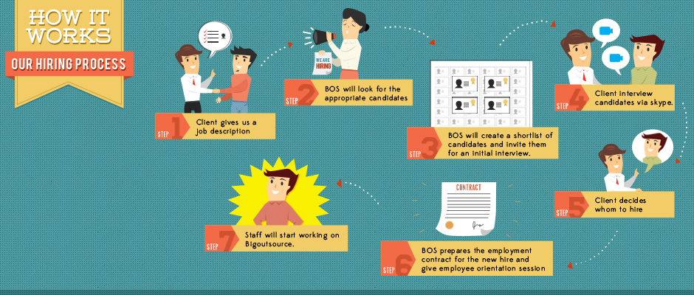
Overview of Hiring Process
ES will advertise and look for appropriate candidates
Rounds of interviews conducted (video conf, in-person, phone, etc.)
New or replacement - Job description created/updated
ES will create a short list of candidates & conduct phone screens
Hiring decision is made; background & reference checks conducted
New employee starts work
ES prepares offer letter/contract & schedules onboarding & benefits orientation

Slide 10
Our New “Jobs” Pages
External
(www.lynn.edu/jobs)
Internal
(www.lynn.edu/studentjobs)

Slide 11
Introduction to ApplicantPRO
https://admin.applicantpro.com/

